Slide 1
Python and Machine Learning
Presented by
Cosmo De Bonis-Campbell

Slide 2
Introduction
We will be learning:
Basic Python,
A few Machine Learning (ML) methods,
How/why they work.
After these sessions, you will:
Be able to use these methods for your data if appropriate,
Have the tools to learn more on your own!
I have a BSc in Computer Science, and am studying PhD statistics, with applications in ecology
Notes:
How presentation will benefit audience: Adult learners are more interested in a subject if they know how or why it is important to them.
Presenter’s level of expertise in the subject: Briefly state your credentials in this area, or explain why participants should listen to you.

Slide 3
Training Outline
Lesson 1: Python – Tues 18th March 10am-4pm
Syntax, and commonly necessary packages.
Lesson 2: Machine Learning – Tues 25th March 10am-4pm
Classification vs Regression
Random Forests and Support Vector Machines
Schedule (both days)
10:00-11:00 – Teaching
11:00-11:25 – Break
11:30-12:30 – Teaching
12:30-13:25 – Break
13:30-14:30 – Teaching
14:30-14:55 – Break
15:00-16:00 - Teaching
Site link: https://github.com/RepentForYourCyns/PythonML_GRC
Notes:
Lesson descriptions should be brief.

Slide 4
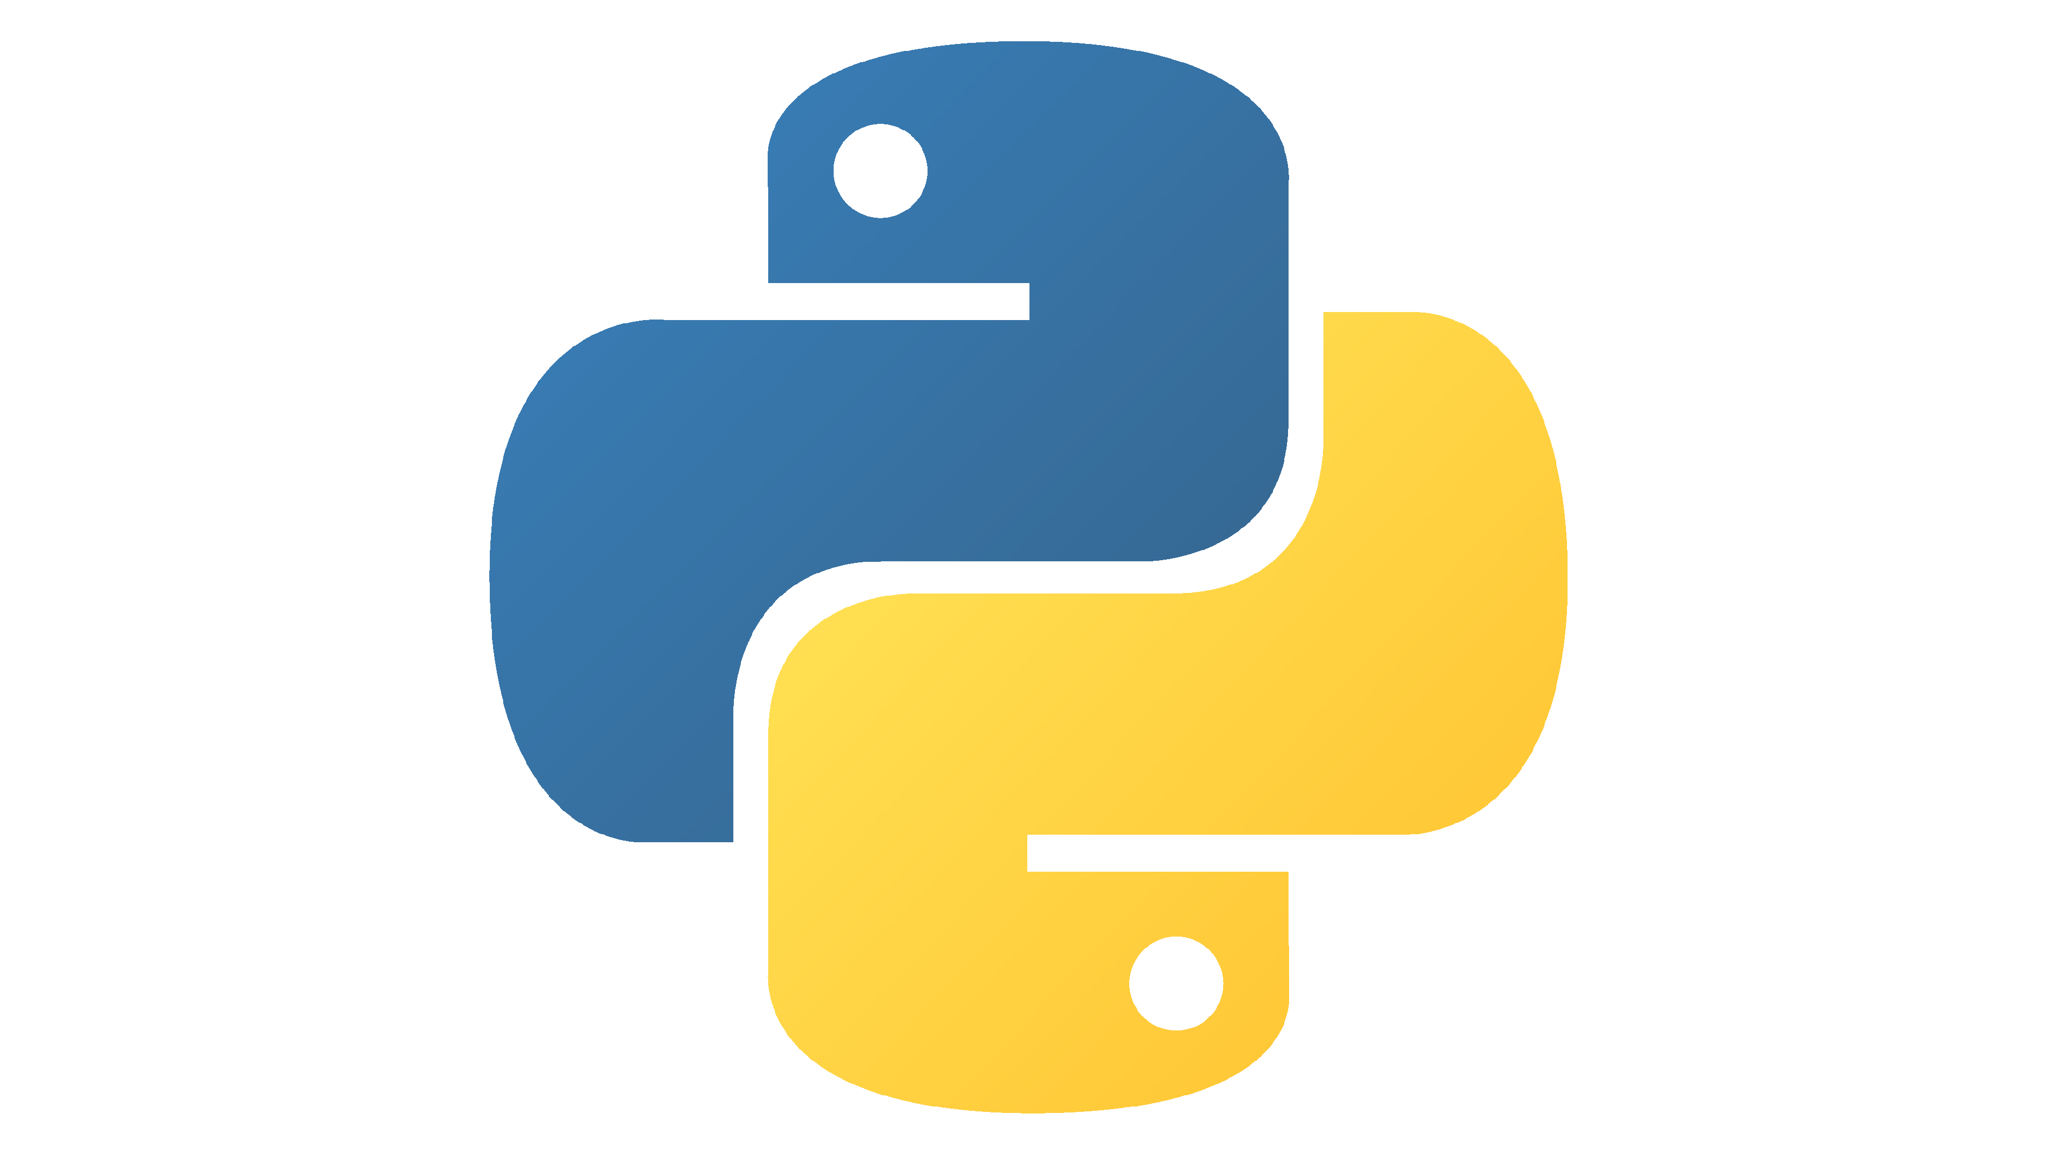

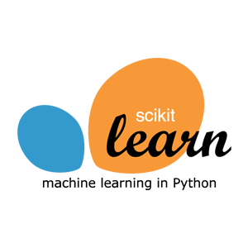




Lesson 1: Python
‘Two-language’ problem (scientific vs machine-friendly)
Readable, popular, and (un)officially well-documented
A package for almost anything – or easy to make one!
Notes:
Example objectives
At the end of this lesson, you will be able to:
Save files to the team Web server.
Move files to different locations on the team Web server.
Share files on the team Web server.

Slide 5
Variables and Objects
A variable is a symbol for a value
E.g. age = 2 #int
Everything in Python is an object
Objects have types
A variable can always have any type of objects assigned to it
E.g. age = ‘two’ #str
Built-in terms (like the names of types) can’t be used as variable names
Comments:
You can add comments to code with ‘#’ – what comes after is not Python anymore. This allows you to explain your code to others (and yourself when you look at it later!)
Common types include:
Numeric: Integers and Floats
E.g. 9, -0.3
Strings (writing)
E.g. “Name”
Booleans (True or False)
Lists
[0, 1, 2]
Tuples – ‘frozen’ (immutable) lists
(0, 1, 2)
Dictionaries
{“one year”: 12, “two years” : 24}
None (means null/nothing)

Slide 6
Collections and Mutability
A collection is any type which is designed to hold other objects: e.g. lists, tuples and dictionaries
Mutable means changeable – some collections let you change which objects they hold (lists and dictionaries), others are frozen on creation (tuples)
Lists and tuples are ordered and are indexed from 0 to the end
Dictionaries have no order and you do the indexing

Slide 7
Collections and Mutability
# list example
my_list[0] = 'This'
my_list[1] = 'is'
my_list
['This', 'is', 'a', 'list’]
len(my_list)
4
# dictionary example
my_dict = {'A': 'alpha', 'B': 'bravo'}
my_dict['C'] = 'charlie’
my_dict
{'A': 'alpha', 'B': 'bravo', 'C': 'charlie’}
# tuple example
my_tup = ('I', 'am', 'immutable')
my_tup[2] = 'mutable' # this will throw an error
Cell In[1], line 3
1 # tuple example
2 my_tup = ('I', 'am', 'immutable’)
----> 3 my_tup[2] = 'mutable’
TypeError: 'tuple' object does not support item assignment

Slide 8
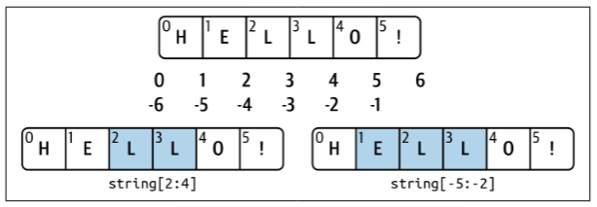
Slices
Any collection with order can be sliced using its numerical index
The index goes backwards from -1 as well as forwards from 0
Slices have the form start:stop:step
The start index is the first index included in the slice
The stop index means ‘stop just before’, i.e. it is never included in the slice
Each index is included only if dividing that index by the step leaves 0 remainder (i.e. every step-th index is included)

Slide 9
Slices
# slicing example
my_str = 'I am a string'
my_str[::3]
'Im rg’
my_str[:6]
'I am a’
my_str[:-2]
'I am a stri’
my_str[:4:-1]
'gnirts a’
# NOTE: this indexing/slicing would be exactly the same for a list or tuple
You can leave start, stop or step unspecified and they will take their default values:
Start: 0
Stop: length of list
Step: 1

Slide 10
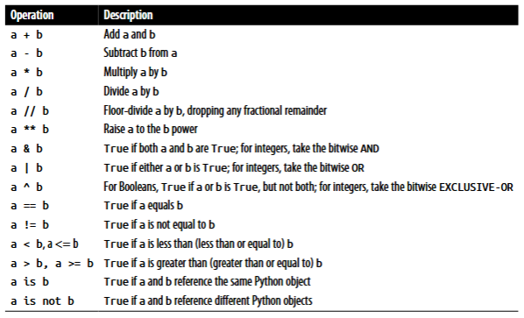
Functions
A function is an object which does something
E.g. overEighteen(age)
Which operator would you use from the list to the right?
Many functions already exist, and you can make your own
We use indentation to indicate that we are inside a function definition (see next slide)
Most Python objects have functions attached to them – these are called methods
Operators are also functions that are made convenient to use

Slide 11
Functions
def overEighteen(age):
return age > 18
overEighteen(23), overEighteen(17)
(True, False)
Indent
(Tab)

Slide 12
Flow control
Branching:
If this is true, then do that
Else, if another thing is true, then do the other thing
Can have as many of these as needed
Else (none of the above are true), do something else
Looping:
While this is true, do that
Will repeat forever if ‘this’ is always true
For each of these things in a collection, do something
The ‘something’ to do can use the things in the collection, or not
(Only one branch can be taken at a time)

Slide 13
Flow control
# loop
i = 0
while i < 5:
print(i)
i += 1 # i = i + 1
0
1
2
3
4
for i in range(5):
print(i)
0
1
2
3
4
# branch
age = 23
if age > 18:
print("You are an adult")
elif age == 18:
print("You are (just barely) an adult")
else:
print("You are not an adult")
You are an adult
Indentation is once again important with branching and looping

Slide 14
Imports
You can import packages in Python
Some are built into Python, like datetime, os and time
datetime provides tools for working with… you guessed it (dates and times)
os allows interaction with operating system
time allow you to time things in Python
These are just some examples, there are far too many to go through them all
Others, like numpy and pandas, are not
These need to be installed
Python comes with a tool called ‘pip’ for installing packages
import os
os.path.abspath('.') # . means 'here’
'/home/wyt/cd586/sandbox/pythongrc’
import numpy as np
np.array([0, 1, 2, 3]) * np.array([4, 5, 6, 7])
array([ 0, 5, 12, 21])

Slide 15
Jupyter
“Hello world!” (traditional since 1972)
Like a cross between a document and a program.
Divided into cells: cells execute code and display output immediately.
Can add text/image cells as well – if we do something complicated, we can use text to explain it to our reader!
Markdown – has a few bells and whistles to help make it look nice
The Golden Goose of repeatability in scientific papers: The Jupyter “Notebook” is the paper – to repeat the study, just press ‘run’!

Slide 16
Jupyter Tips
Jupyter gives you hints when you hover your mouse over Python variables to tell you about them. Use this to help you!
Jupyter also helps you autocomplete things if you use the ‘tab’ key. This can be very helpful too!
You can find good documentation for every function we will use online!
This is one of the most amazing but under-appreciated things about Python
Also true for R!
Many more hints to help you in the Lesson 1 exercise notebook!

Slide 17
Lesson 1: Exercise
Open Colab (which is where we will play with Python)
Go through the exercises – they will re-explain Lesson 1 with examples and prompt you to interactively explore!
At the end of the exercises, you can look at some real programs (or “scripts”)
Why don’t they work correctly? How can we fix them?

Slide 18
Lesson 2: NumPy and Pandas
Two Python packages
Some packages (like datetime) are built-in – NumPy and Pandas are not
NumPy is Numerical Python – it makes lists much better
Pandas is Python Data Analysis – it brings Excel-like tables to Python

Slide 19
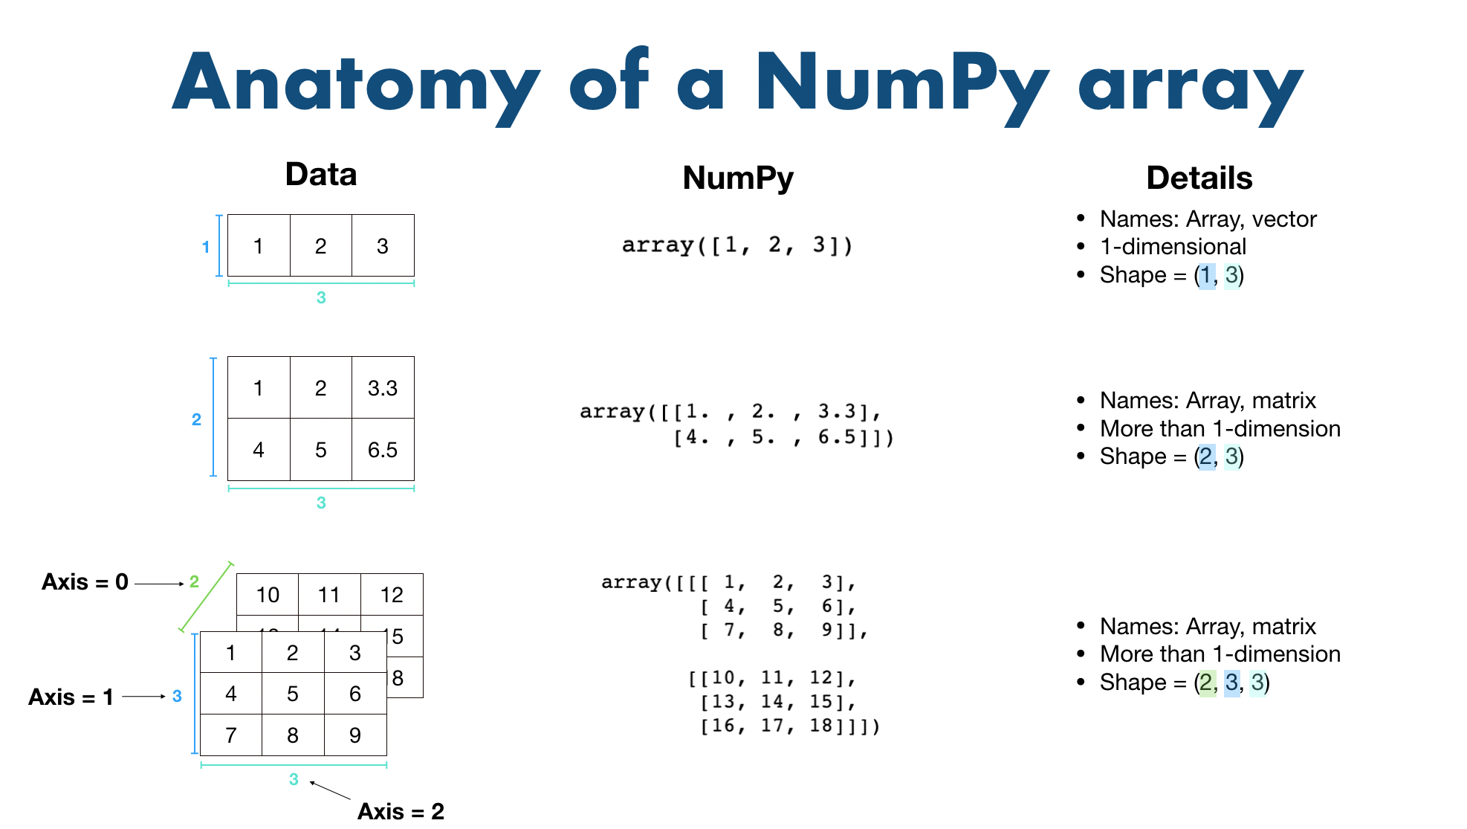
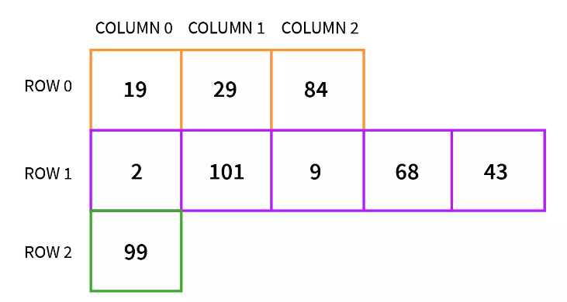
NumPy arrays
“Array” just means list in tech-speak. We distinguish these from ‘vanilla’ Python lists.
NumPy arrays can have multiple dimensions and have “shape” – like a matrix.
They cannot be “jagged”
Jagged
array

Slide 20
NumPy arrays – why?
Operations on arrays are natively parallel – done all at once, rather than step-by-step
We often call this a “vectorised” operation
‘Fancy’ indexing – we can construct any list of indices, or use a condition to generate a True/False “mask” over the array, and get those indices from the list
Better than slices, which are restricted to equal-size steps!
In order that these should work properly with their special properties, the entire array must be the same type (unlike a Python list, which can mix types)

Slide 21
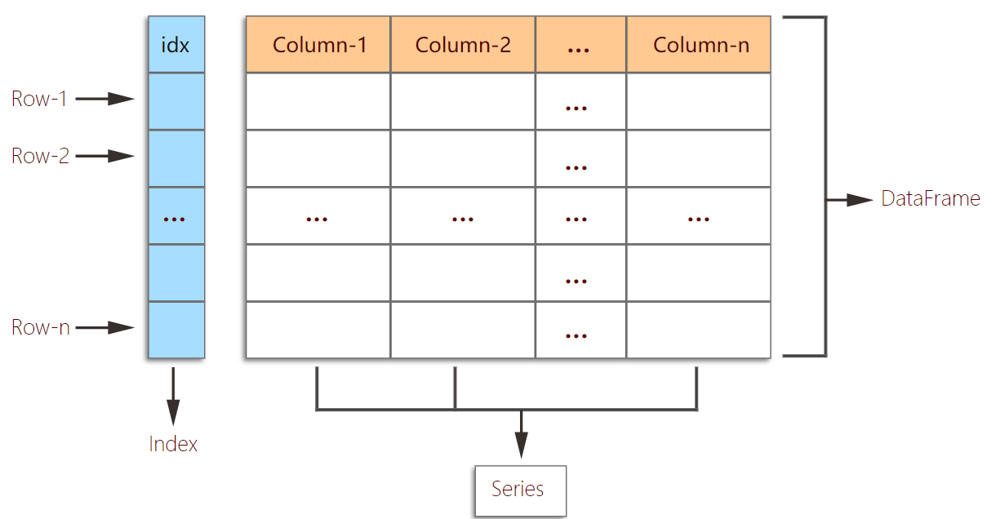
Pandas tables (DataFrames)
A “DataFrame” is a table
DataFrames are made of columns
Each column is called a Series – you can also have these on their own
You can create a DataFrame from a dictionary of lists (but the lists must be equal length, so that the dictionary is ‘square’ like a table)

Slide 22
DataFrames – why?
A lot of data is stored in tables
One special column is called the index – this locates each row of the table (and is not a pandas Series, unlike the other columns)
The index does not have to be 0, 1, 2…
e.g.: dates, human names, coordinates
DataFrames and Series are packed with useful methods! E.g. .describe(), .mean(), .nunique()

Slide 23
Lesson 2: Exercise
Let’s take some real data, read it into a DataFrame, plot some graphs, and finally take the values we want (as a NumPy array)
Extension: how can we make sure all numerical values are between 0 and 1?
We call this a normalised scale and the process normalisation
Then, we’re ready to begin machine learning!

Slide 24
Optional (but recommended) homework
There isn’t enough time to cover the following topics in detail:
Hierarchical indexing
Join/merging
GroupBy
String and time series “accessors”
The worksheet will provide examples and tasks in small steps to help you understand these, if you want. Any questions, just ask!
I am cd586@kent.ac.uk on Outlook and Teams ☺
For further reading, I highly recommend Jake VanderPlas’ Python Data Science Handbook available online for free (!) at:
https://jakevdp.github.io/PythonDataScienceHandbook/

